Slide 1
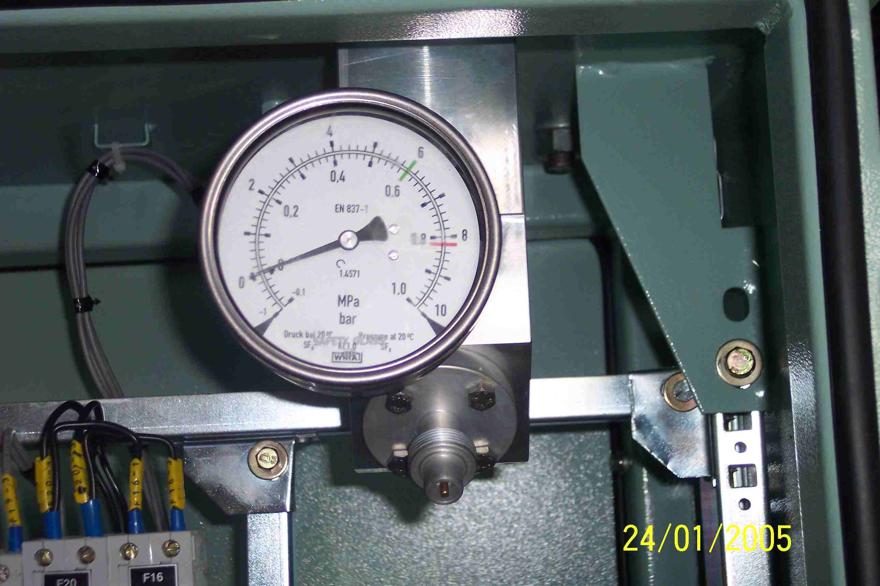
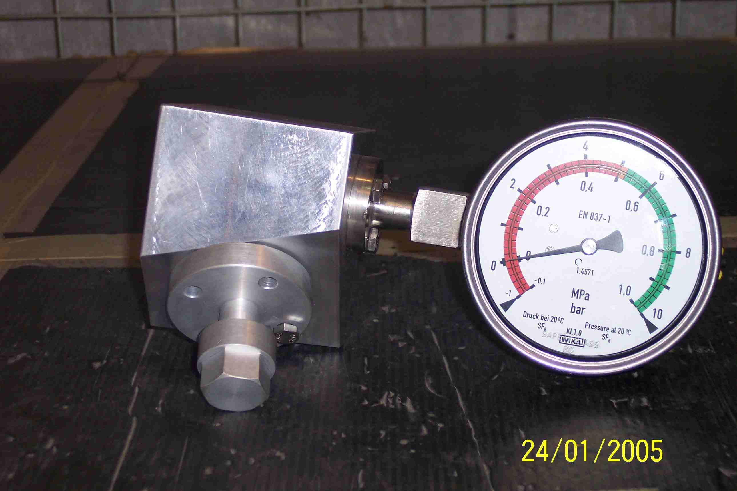
SIEMENS
HVCB SPARES
Pressure gauge
S4799167001
Pressure gauge
S4712554101
Same For 72.5KV, 145KV HVCBs
For 245KV HVCBs

